Slide 1

STRUCTURAL CONTRASTIVE LEARNING FOR IDENTIFICATION OF COMPLEX PELVIC FRACTURES
GUIDE:
Dr. Ramakrishnan. S
Asst. Professor –III
School of Computing
TEAM MEMBERS:
Daanish D - 125003061
Dharuneswar K - 125003438

Slide 2
AGENDA
Motivation
Objective
Base Paper
Problem Statement
Literature Survey
Dataset
Workplan
Proposed Techniques
References

Slide 3
MOTIVATION
Pelvic fracture is a severe trauma with high morbidity and mortality, especially in the elderly.
The Computed Tomography(CT) is routinely used for the diagnosis and surgical planning of pelvic fractures.
Current fracture detection model is based on either Edge-detection of the cracked area, using the geometric properties of bone structures or it is constructed automatically using a huge annotated dataset using machine learning techniques.

Slide 4
OBJECTIVE
The unique method of analysing the symmetric properties of the pelvic anatomy and comparing the differences in the density of the fractured side and the normal side, gives the potential area of fracture in the pelvis region.
A DBSCAN-based algorithm is used to detect potential fracture areas from point clouds obtained from the segmentation results.

Slide 5
BASE PAPER
Two-Stage Structure-Focused Contrastive Learning for Automatic Identification and Localization of Complex Pelvic Fractures
Journal: IEEE Transactions on Medical Imaging
Year Of Publication:2023
Authors: Bolun Zeng , Huixiang Wang, Jiangchang Xu , Puxun Tu , Leo Joskowicz

Slide 6
PROBLEM STATEMENT
The evaluation of pelvic bone fracture is time-consuming, hard, and often leads to inaccurate detection due to structural complexity of pelvic bones, significant difference in fragment size and irregular morphology.
A structure-focused attention(SFA) module is designed to capture the spatial structural features and enhances the recognition ability of fracture zones.

Slide 7
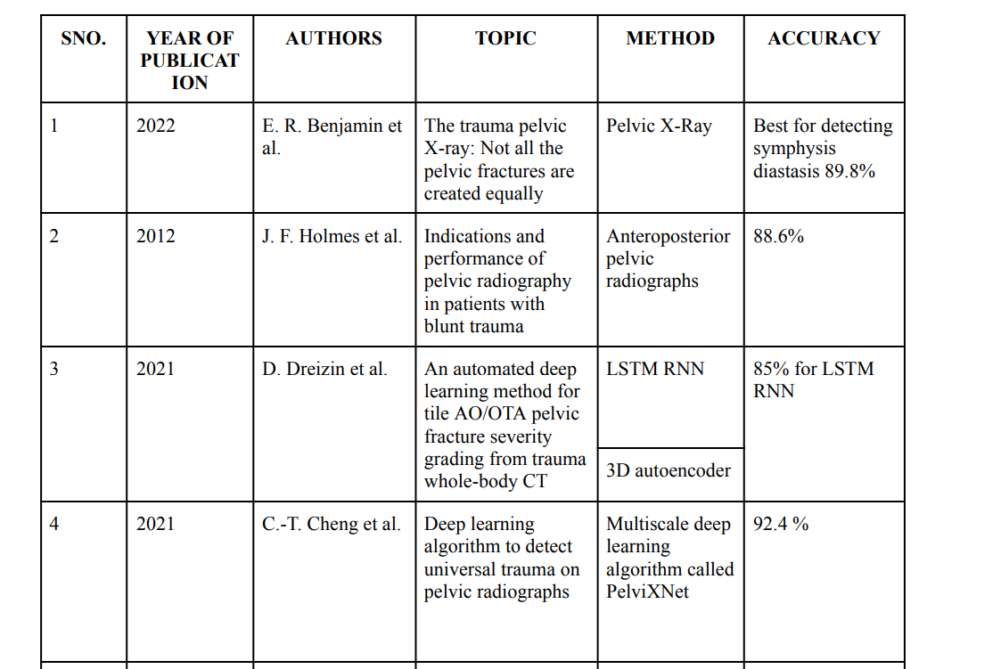
LITERATURE SURVEY

Slide 8
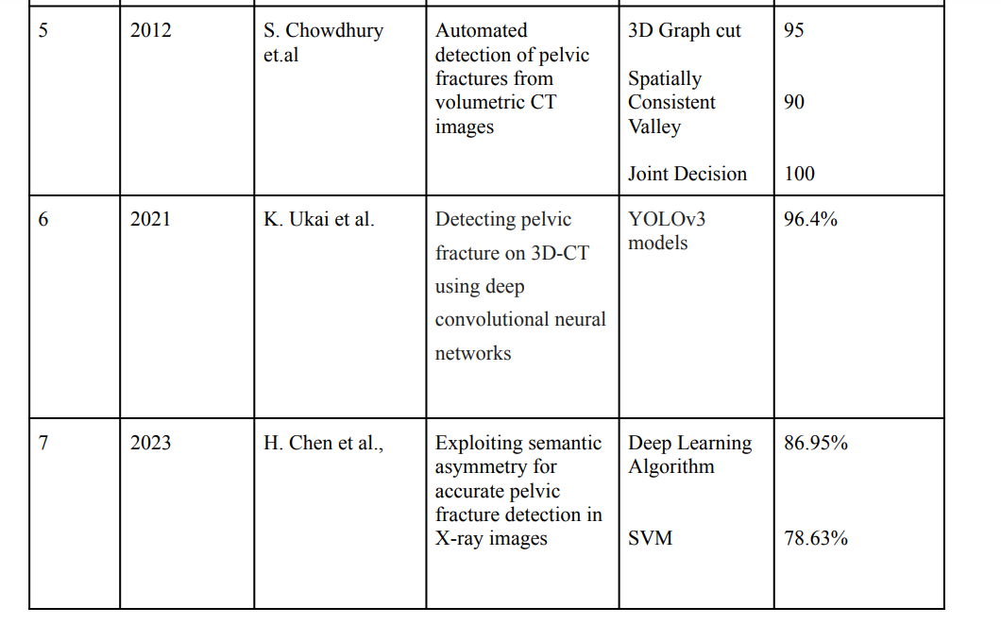
LITERATURE SURVEY

Slide 9
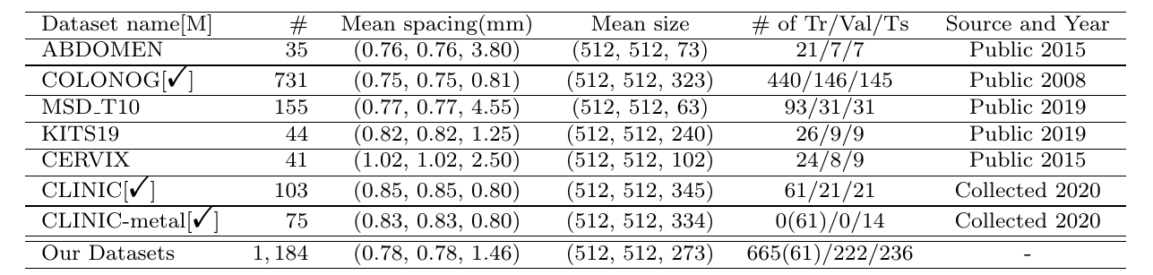
DATASET
The proposed method will be validated in the dataset CLINIC, which is a subset of the dataset CTPelvic1K .
This dataset consists of 103 CT scans of clinical cases of pelvic fracture; each scan includes annotations of the lumbar spine, sacrum, and left/right innominate bone.
The image size varies from 512×512×294 to 512×512×388, with a median value of 512×512×350. We normalized the image intensity to the range of [0, 128].

Slide 10
WORK PLAN
SNO. | OBJECTIVE/GOAL | TIME
1 |  | MONTH-1 (0TH REVIEW)
2 |  | MONTH-2 (1ST REVIEW)
3 |  | MONTH-3 (2ND REVIEW)
Gathering dataset
Primary Image processing
40% Code Completion
Segmentation of CT Image
Marching Cube Algorithm
100% Code completion

Slide 11
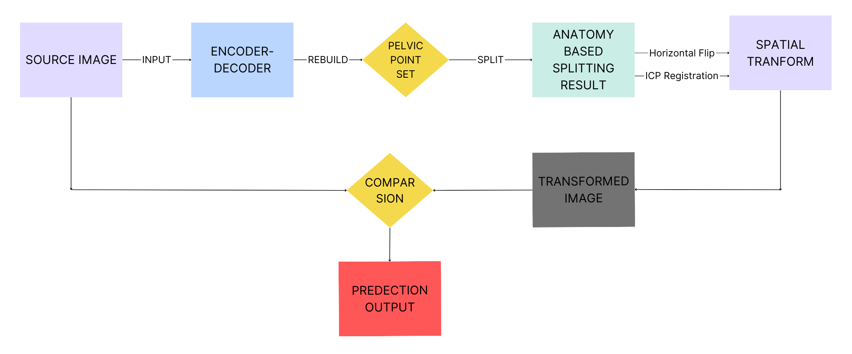
PROPOSED METHODOLOGY
Block Diagram Describing the overall flow of the project

Slide 12
PROPOSED METHODOLOGY
Extraction of Potential Fracture Zones
1) Segmentation Of The Pelvis
In the CT scan images, the pelvis exhibits a distinct intensity gradient and relatively fixed morphology and position.
UNet is proposed to identify the pelvis and classify it into three classes, the left innominate bone, the right innominate bone, and the sacrum.
Since the implementation of potential fracture area generation needs to be based on point cloud data, the segmentation results are rendered in 3D with the Marching Cube algorithm for different categories, and further transformed into surface point clouds

Slide 13
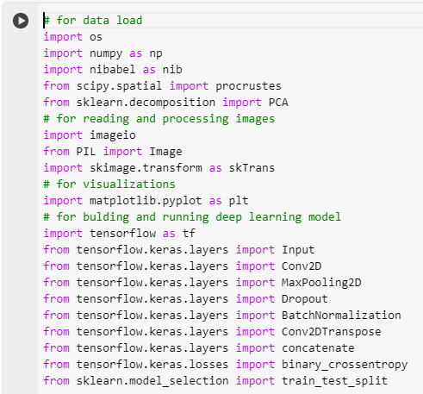
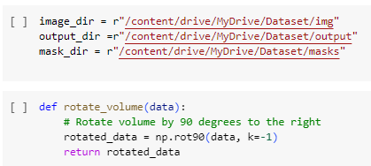
Implementation
Importing

Slide 14
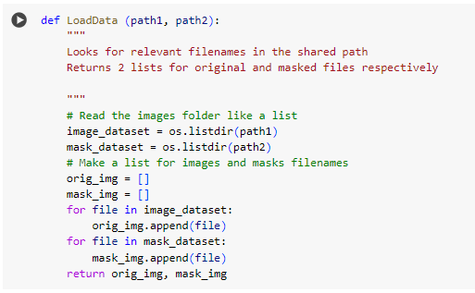
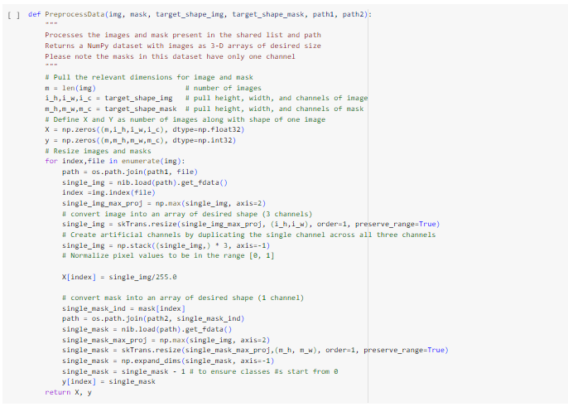
Implementation
Loading and Processing

Slide 15
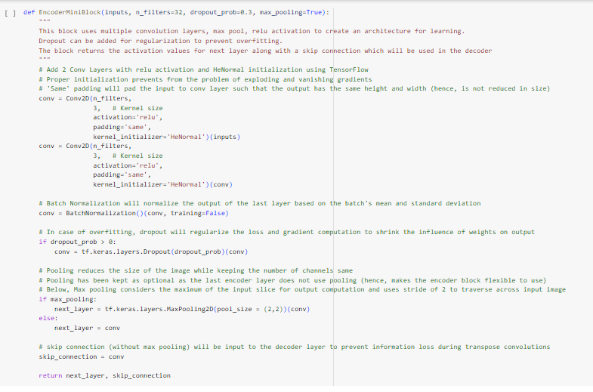
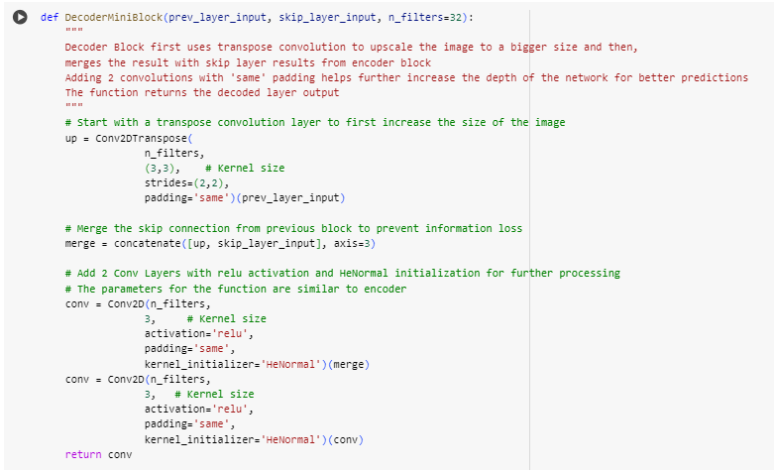
Implementation
Encoding and Decoding

Slide 16
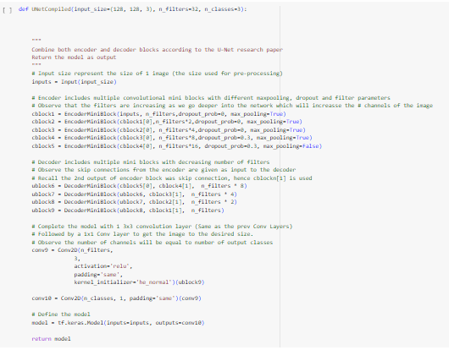
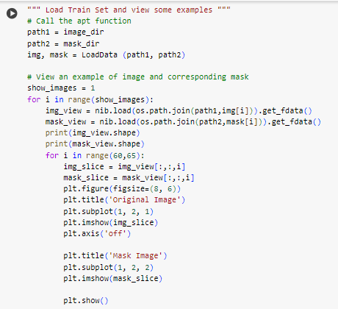
Implementation
UNet

Slide 17
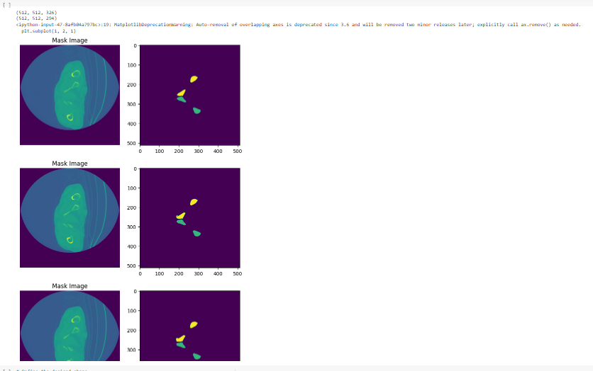
Implementation
Output

Slide 18
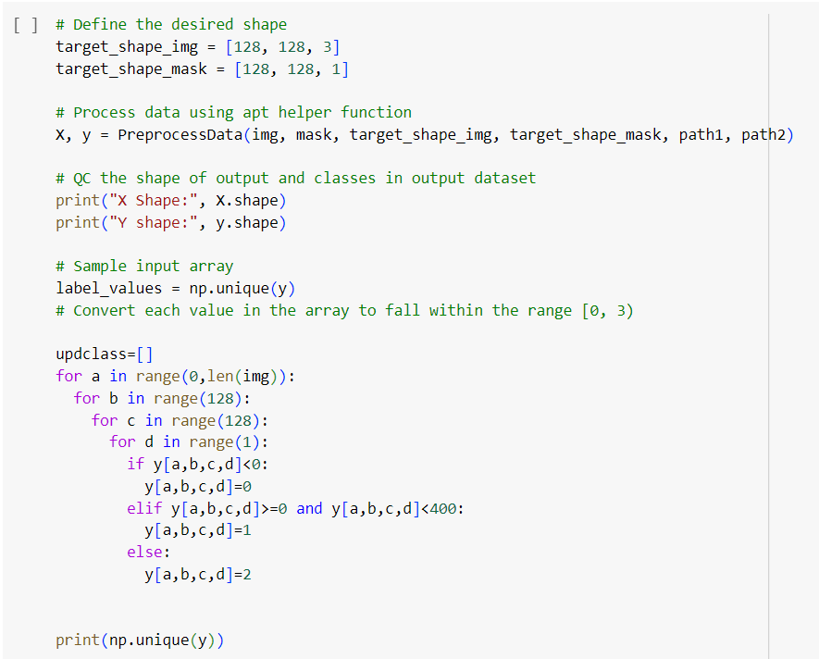

Implementation
Labelling The Channels

Slide 19
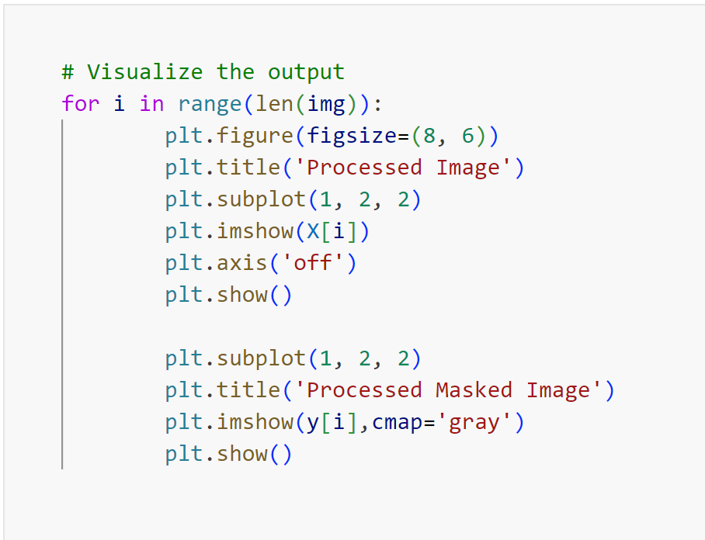
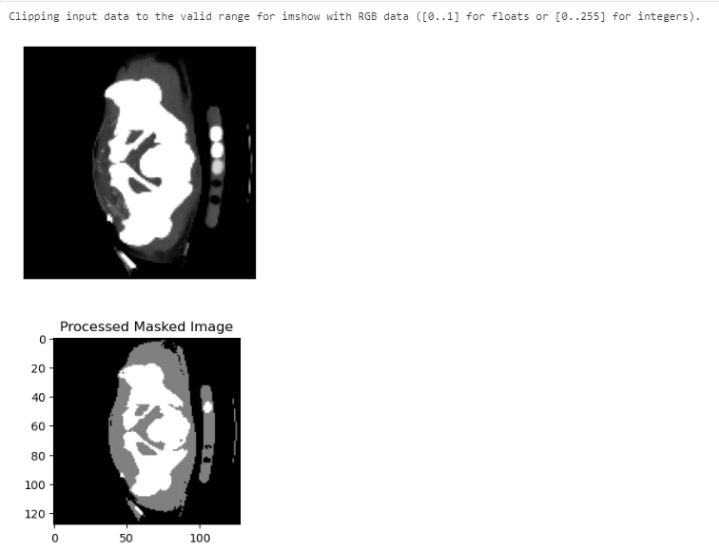
Implementation
Visualizing

Slide 20
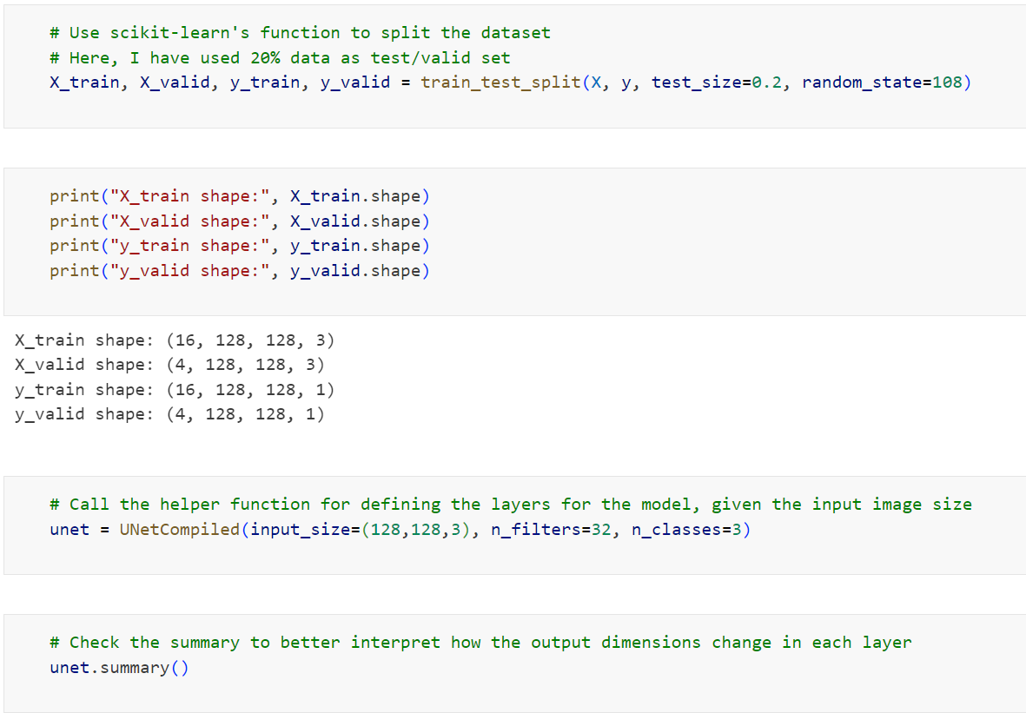
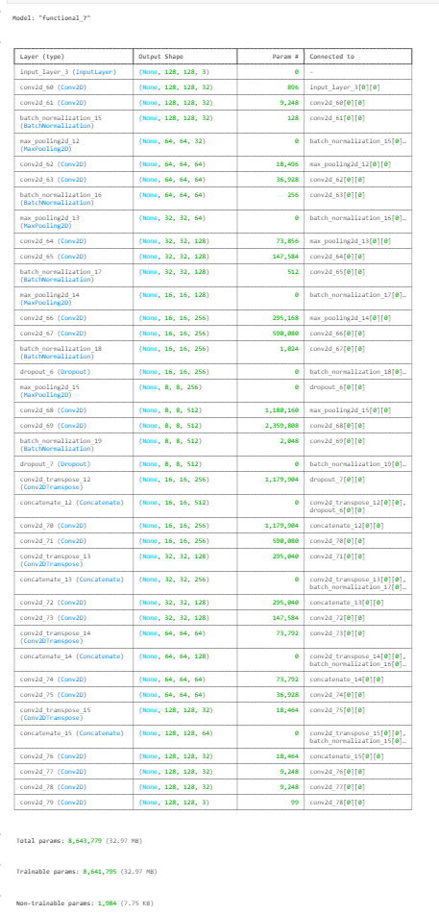
Implementation
Labelling The Channels

Slide 21
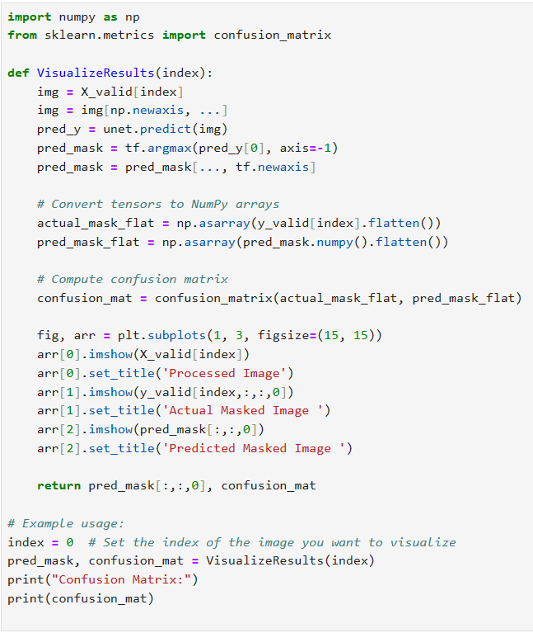
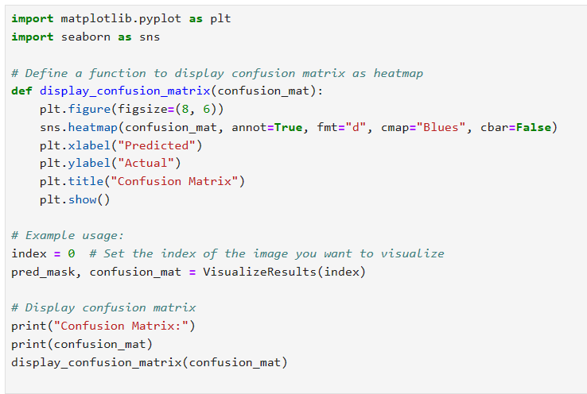
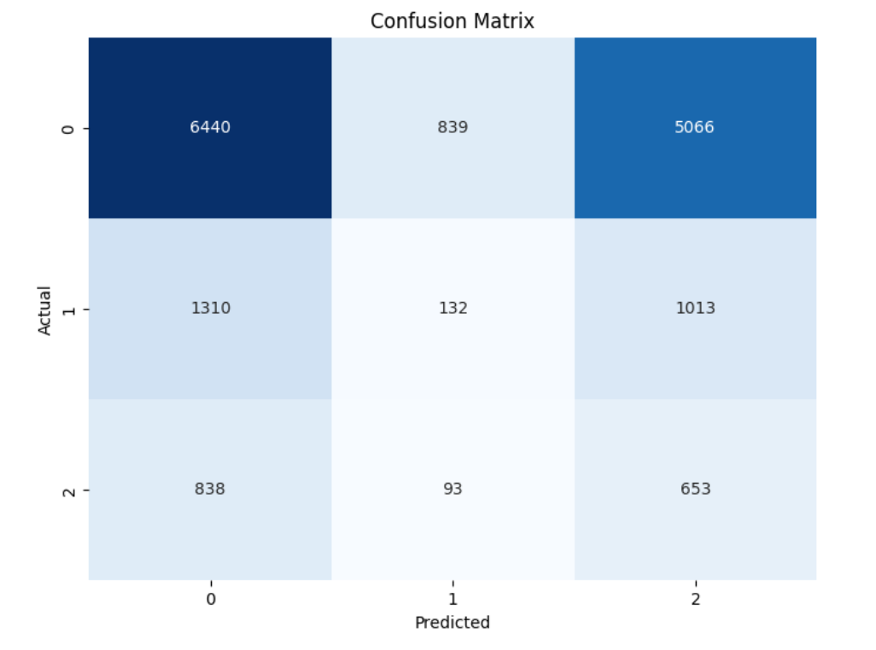
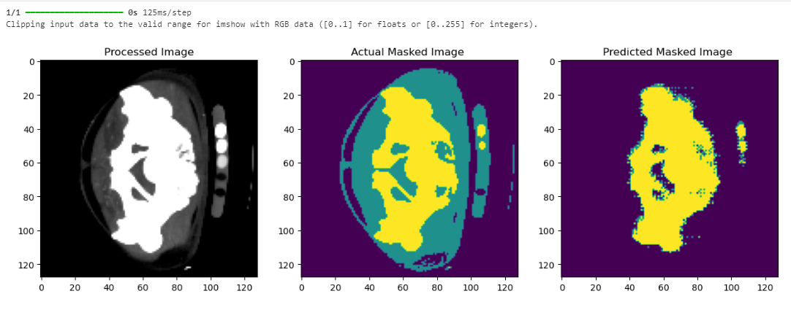
Implementation
Validating

Slide 22
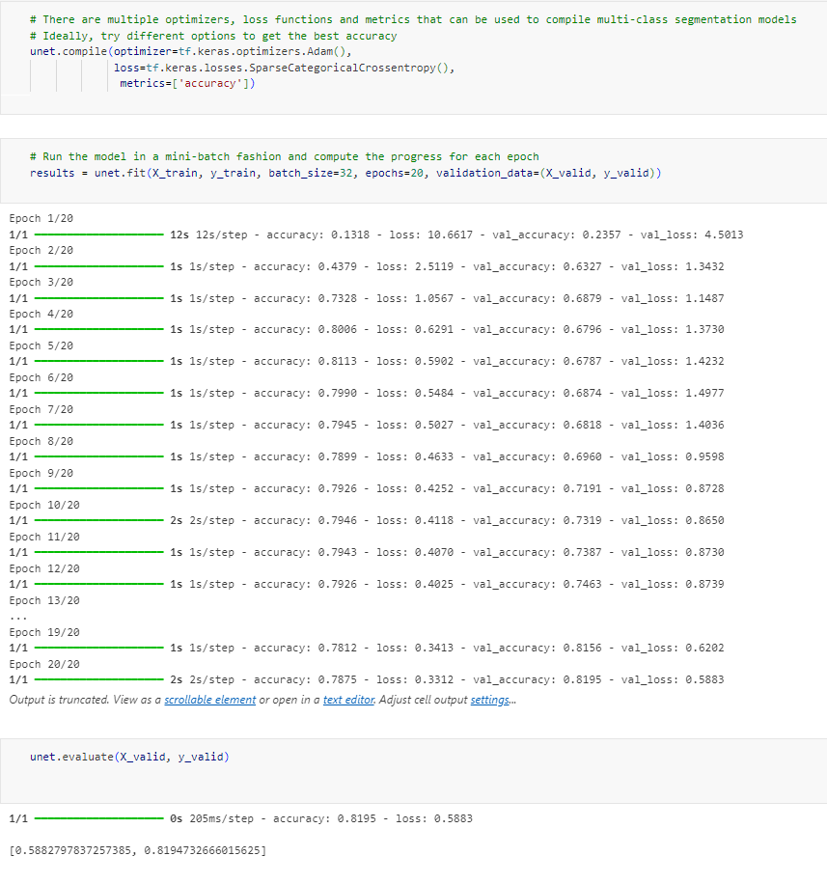
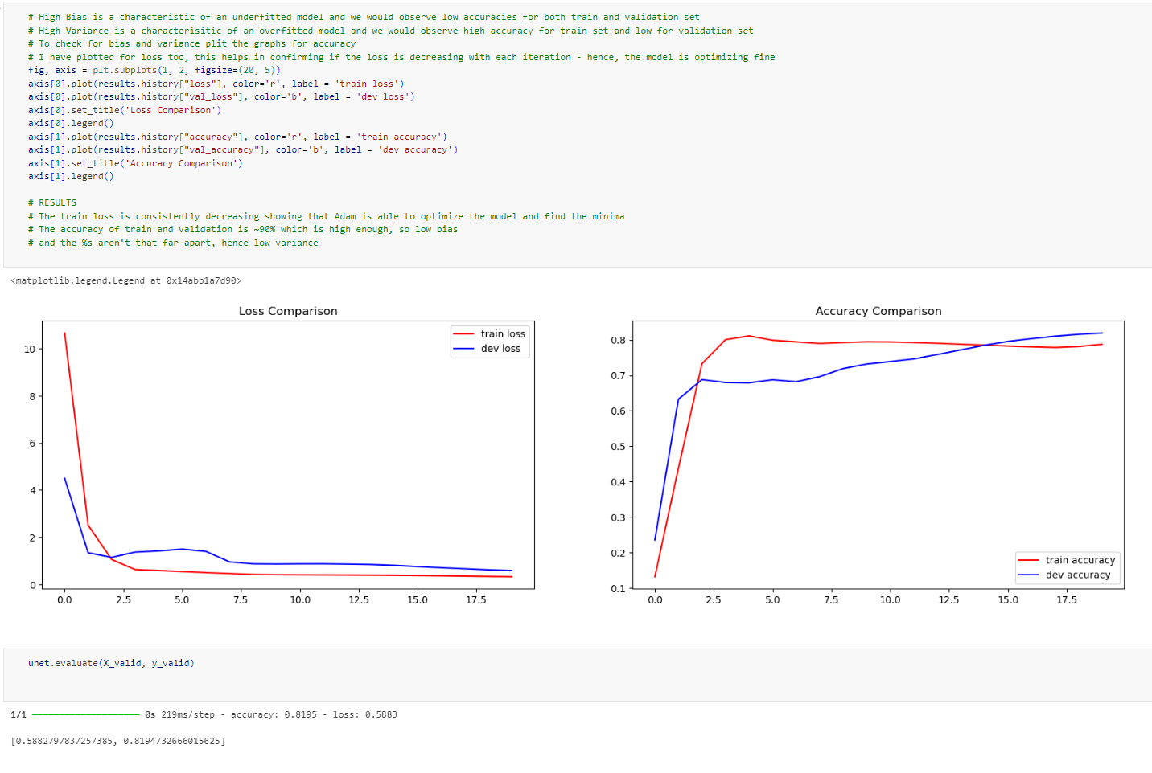
Implementation
Results

Slide 23
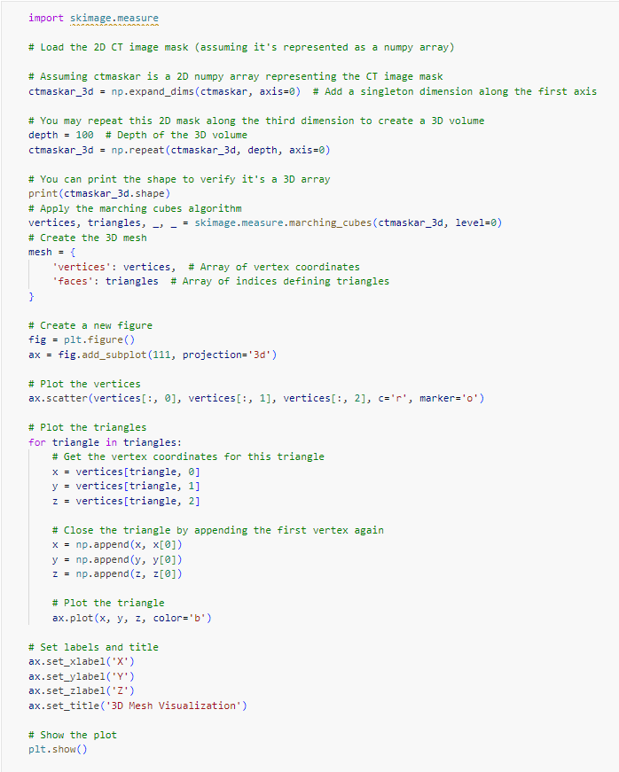
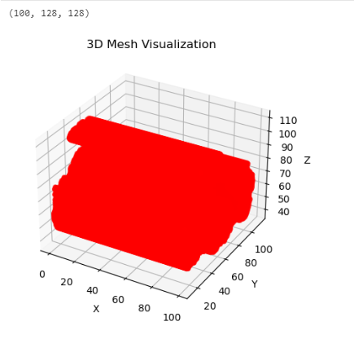
Implementation
Marching Cube Algorithm

Slide 24
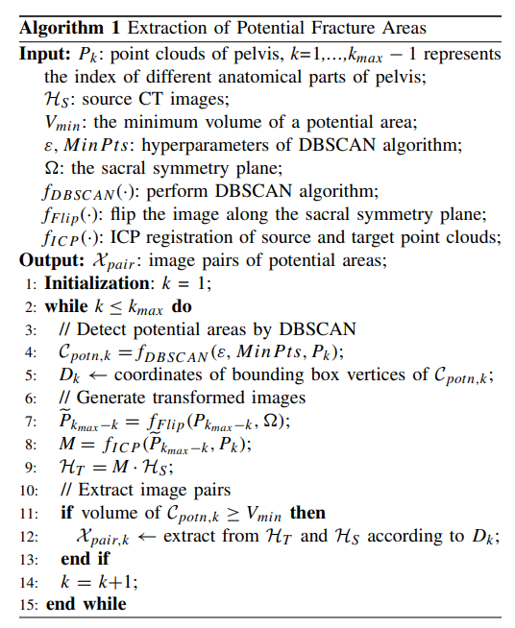

PROPOSED METHODOLOGY
2) Generation Of Potential Fracture Areas
The density-based cluster algorithm DBSCAN is employed to automatically detect the fracture area points with higher density. DBSCAN defines areas with a sufficient point cloud density in the neighbourhood as clusters, and other areas as noise, which depends on two parameters: the maximum radius if the cluster E and the minimum number of points in the radius, minPts.

Slide 25
PROPOSED METHODOLOGY
3) Extraction Of Fracture Zone In The Image Domain.
For the left and right innominate bones, one is used as the target point cloud, the other is flipped along the sacral symmetry plane Omega and used as the source point cloud.
Next, the Iterative Closest Point (ICP) algorithm will be applied to compute the spatial transformation matrix M, which will be used to rotate and translate the flipped source image to obtain the transformed image that is aligned with the source image in the pelvic region.

Slide 26
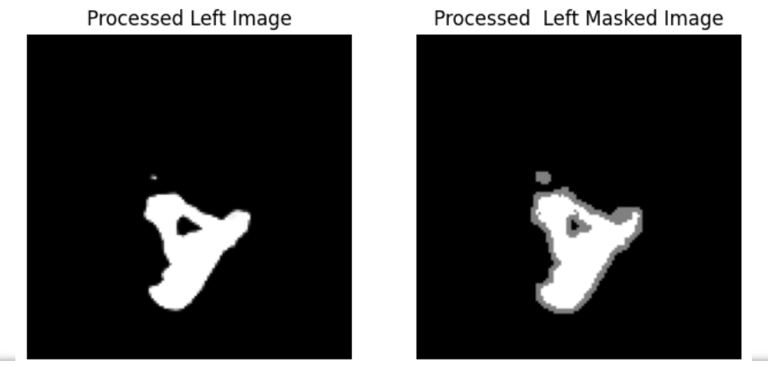
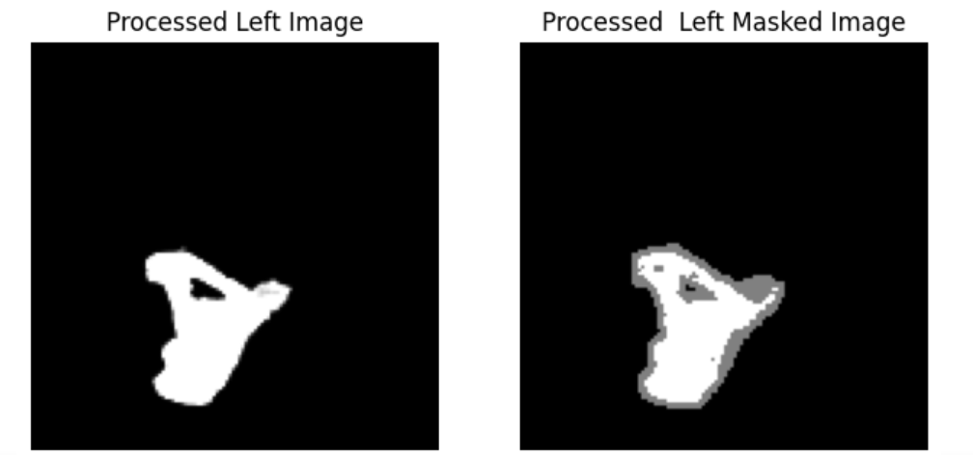
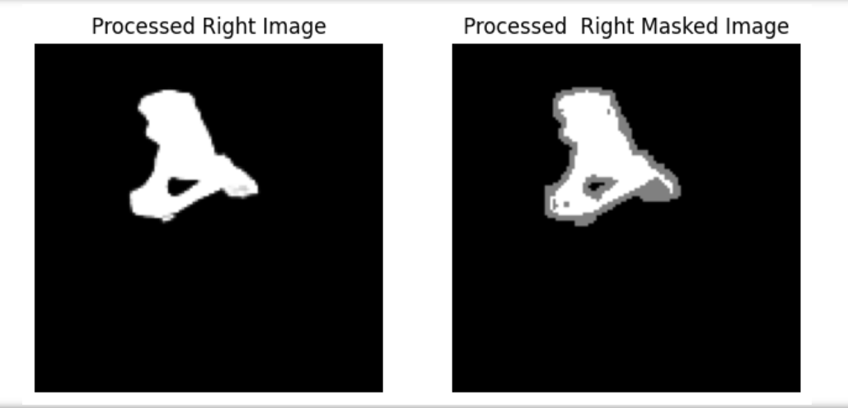
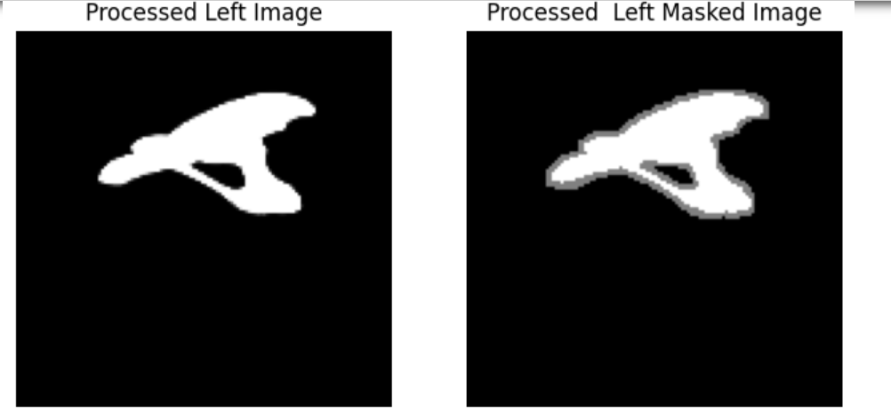
CT IMAGE ITERATED THROUGH IMAGES
Left Segmented Bone
Right Segmented Bone

Slide 27
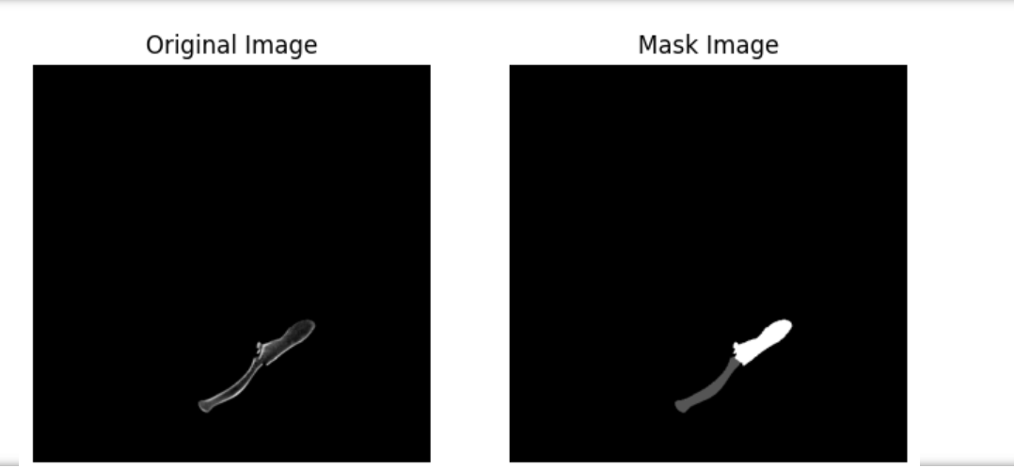
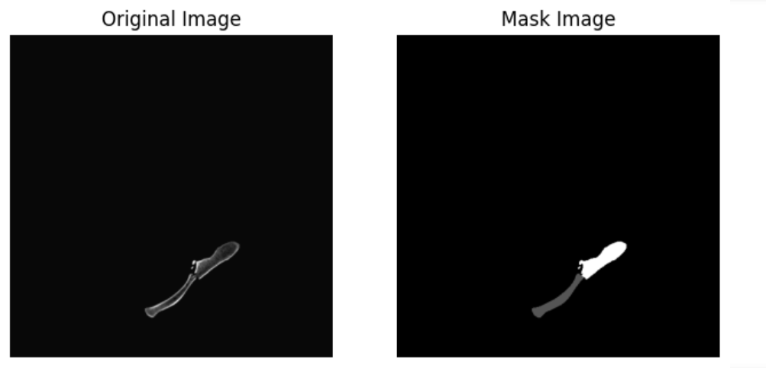
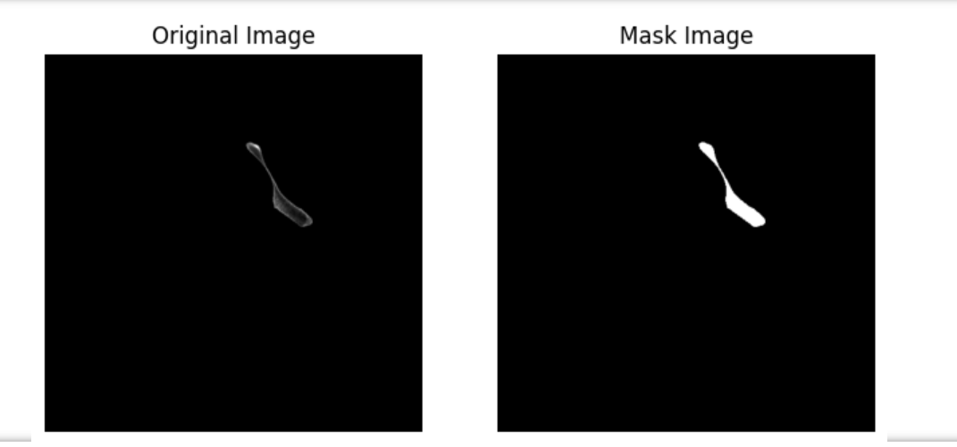
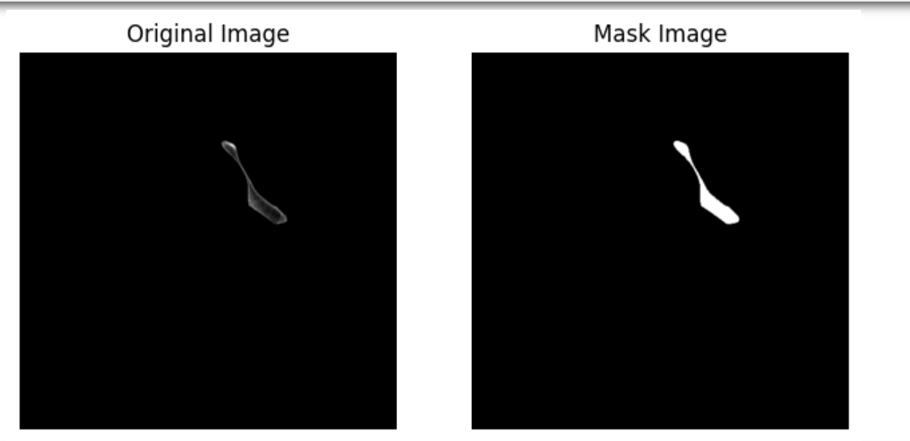
CT IMAGE ITERATED THROUGH SLICES
Left Segmented Bone
Right Segmented Bone

Slide 28
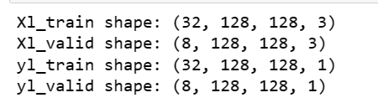
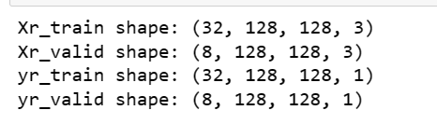
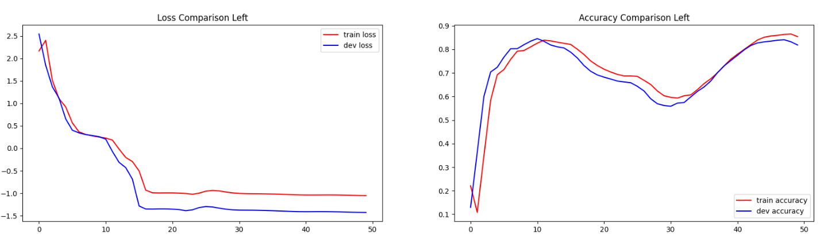
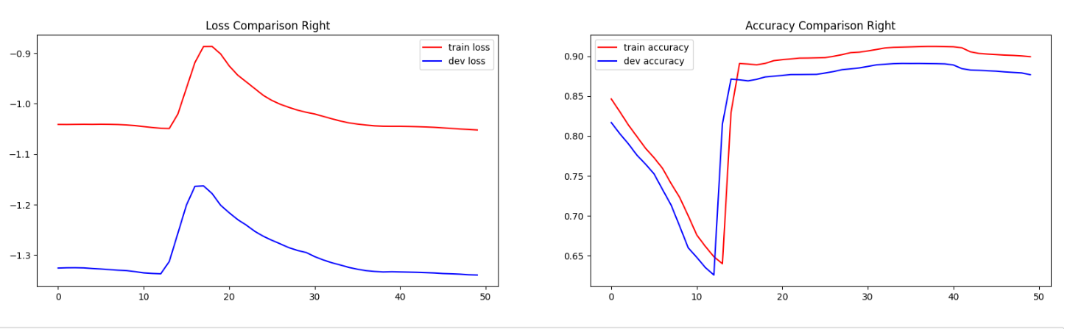
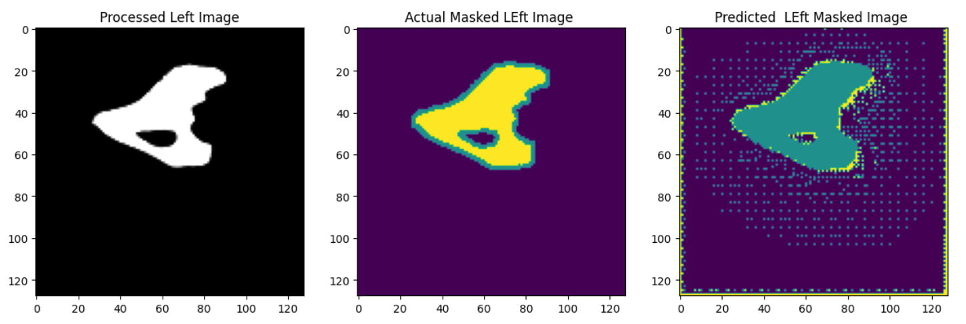
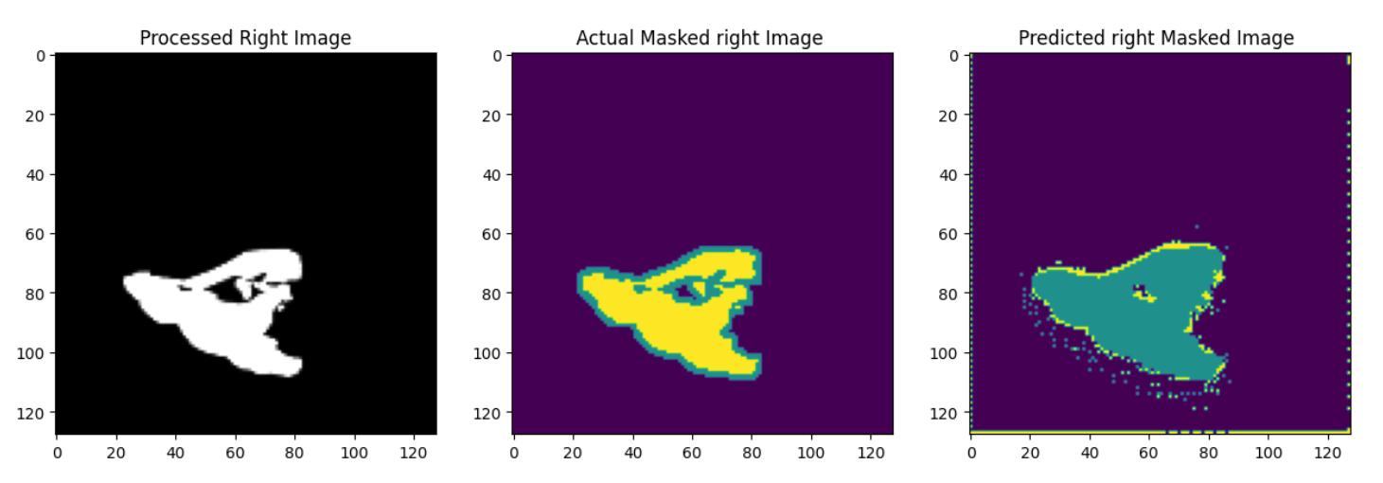
SNAPSHOTS WITH NEW DATA

Slide 29
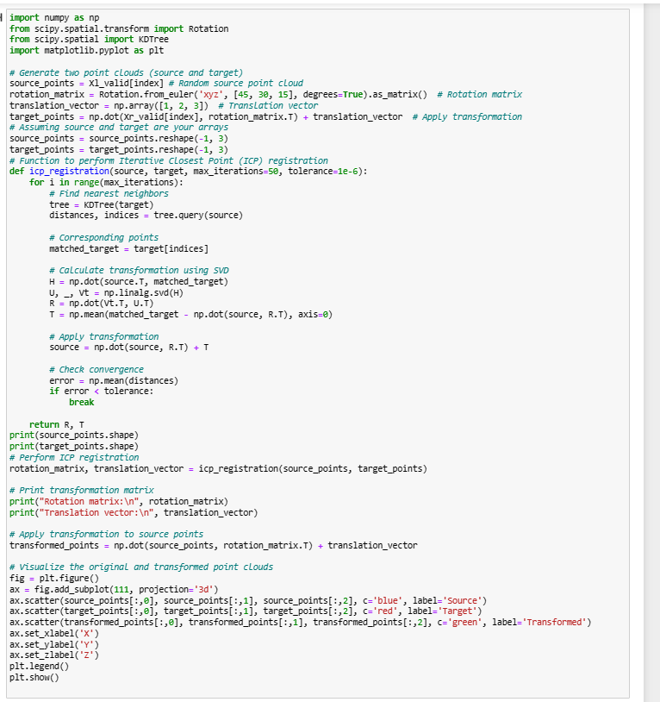
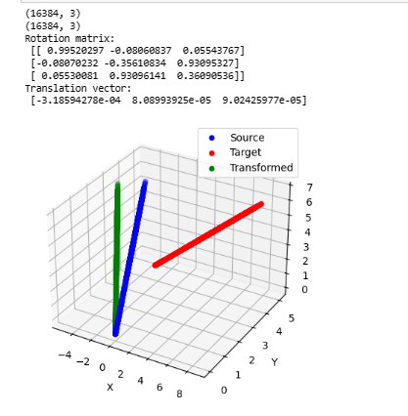
ICP Registration with Rotation and Transformation Vector

Slide 30
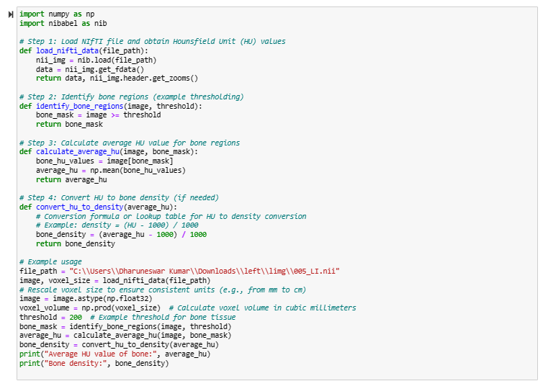
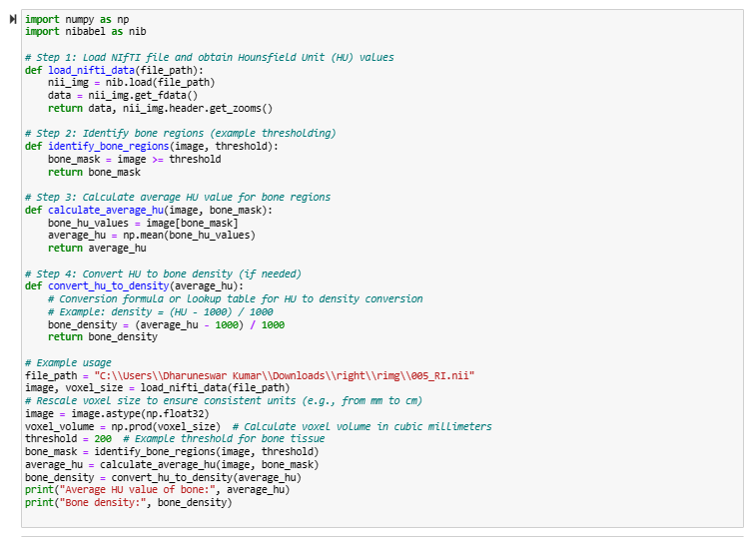
Density analysis

Slide 31
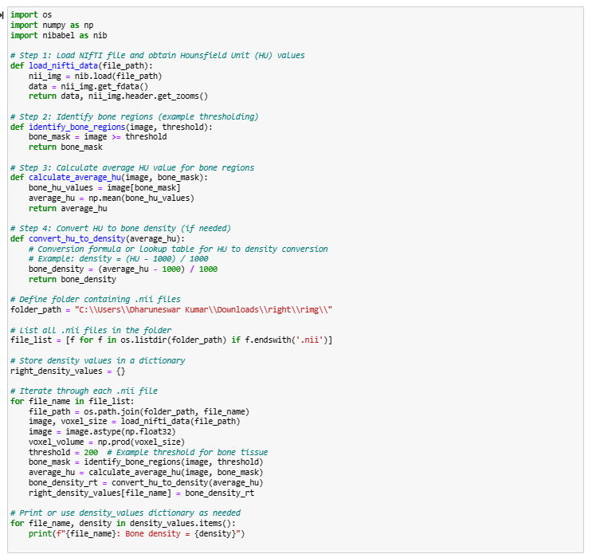
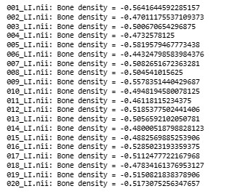
Hounsfield Units(Right Segment)

Slide 32
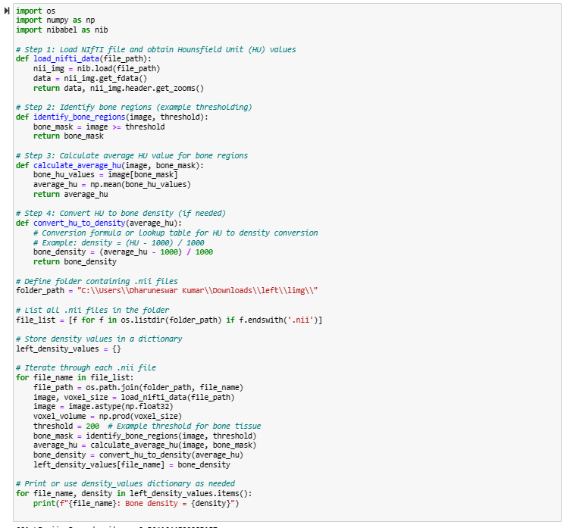
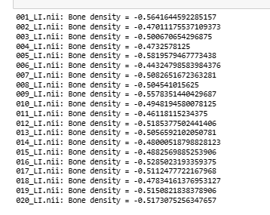
Hounsfield Units(Left Segment)

Slide 33
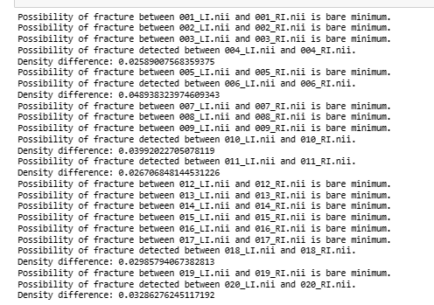

Result analysis

Slide 34
INDIVIDUAL CONTRIBUTION
DAANISH D:
Content Creator for Presentation
To carry out Segmentation of Pelvis.
Generation of potential fracture zones
DHARUNESWAR K :
Prepared presentation slides .
Extraction and Pre-processing of the image dataset
Extraction of fracture zones in Image domain

Slide 35
REFERENCES
M. Ester, H. P. Kriegel, J. Sander, and X. Xu, “A density-based algorithm for discovering clusters in large spatial databases with noise,” in Proc. 2nd Int. Conf. Knowl. Discovery Data Mining, 1996, pp. 226–231.
D. Dreizin et al., “An automated deep learning method for tile AO/OTA pelvic fracture severity grading from trauma whole-body CT,” J. Digit. Imag., vol. 34, no. 1, pp. 53–65, Feb. 2021
W. E. Lorensen and H. E. Cline, “Marching cubes: A high resolution 3D surface construction algorithm,” ACM SIGGRAPH Comput. Graph., vol. 21, no. 4, pp. 163–169, Jul. 1987

Slide 36
THANK YOU

